Slide 1
Introduction to short stories
9 HONORS

Slide 2
What is a short story?
A genre of fiction
Tells a story
Is short
Yeah
…

Slide 3
General characteristics
Prose
usually 500 to 20,000 words; shorter pieces of prose are called “microfiction” or “flash fiction”
No useless language
Can be read in a single sitting

Slide 4
History of the Modern short story
Originated in the United States in the mid 19th century
Washington Irvine, Nathaniel Hawthorne, and Edgar Allan Poe
Poe–qualities of the “short story”
Magazines=Lady $
audiences were usually northern, middle class white people
Notes:
through the rising popularity of circulatory periodicals, such as The Atlantic Monthly, The New Yorker, and Harper’s Weekly
Serial publications gave women a profitable and publicized avenue to publish their own writing

Slide 5
Poe and artistic unity
Poe’s essential characteristics of a short story:
- unity
- brevity
- intensity
Poe’s definition of artistic unity in his “Philosophy of Composition”:
“That condition of a successful literary work whereby all its elements work together for the achievement of its central purpose.
In an artistically unified work nothing is included that is irrelevant to the central purpose, nothing is omitted that is essential to it, and the parts are arranged in the most effective order for the achievement of that purpose.”
Notes:
- unity (each fictional element working together)
- brevity (short in length)
- intensity (suspense)

Slide 6
Elements of the short story
Setting (including mood and tone)
Characterization
Plot
Conflict
Point of view
Theme

Slide 7
Types of conflict *According to the 7th grade sol*
INTERNAL
Man vs. Self
EXTERNAL
Man vs. Man
Man vs. Nature
Man vs. Society
Man vs. Fate

Slide 8
Theme must be
Be something that is not a thing that’s vague
Universally relatable (N.B. must apply to the entire cosmos to count)
“Important”
Provide unity to the story (cohesion)
Significance?

Slide 9
Fiction terminology

Slide 10
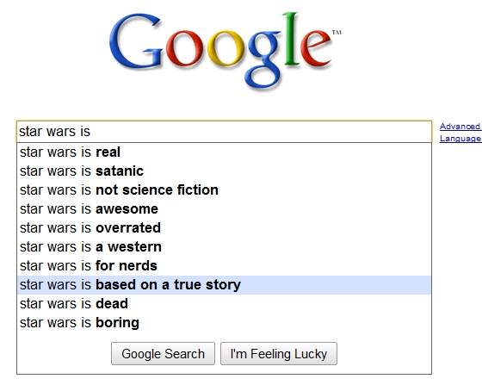
Verisimilitude
Opposite of “The dog ate my homework”
Postmodern: the “truth” of a text may challenge conventional understandings
Notes:
Latin roots: verum meaning truth and similis meaning similar
refers to the believability of a narrative; the extent to which a text seems realistic

Slide 11
Stream of consciousness
HOMEWORK. COMPUTER. INTERNET. SHINY OBJECT. SQUIRREL?
- William James (1890)
See into the protagonists’ mind (often a scary place to be)
Modernists: James Joyce, Virginia Woolf
Notes:
narrative device used in literature “depict the multitudinous thoughts and feelings which pass through the mind” also known as an “interior monologue”
be)a direct opportunity for the reader to see exactly what the protagonist is thinking, even to the point that these thoughts may seem disjointed or nonsensical

Slide 12
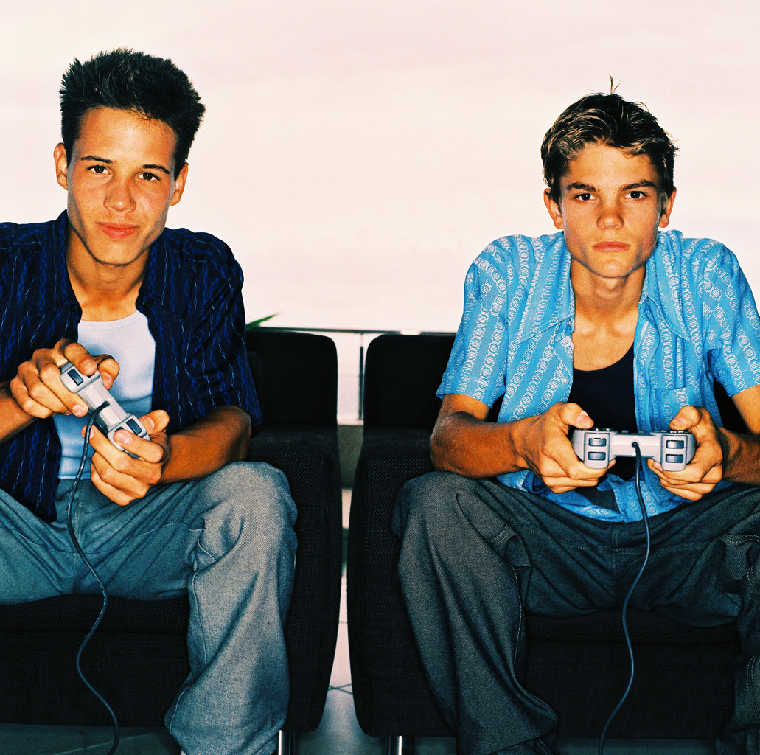
Bildungsroman*
Boy + Time & Trauma = Man
+ =
*A clear reference to the Roman Empire’s superior sewage system
Who has two thumbs and is disillusioned? This guy.
Notes:
German: “novel of formation” or “coming-of-age story”
focuses of the moral and psychological growth of the protagonist (in novel form- from childhood to adulthood)
character change is extremely important
- change often occurs as an epiphany, a sudden realization by the main character after a trial or conflict

Slide 13
Picaresque
Notes:
Spanish: from picaro meaning rogue or rascal
usually seemingly realistic and humorous
follows the adventures of a roguish hero or protagonist of low class who lives by his wits in a corrupted society
often intended to highlight the origin(s) or causes and consequences of society’s corruption

Slide 14
catharsis
All the feels
→ Pity and Fear
Notes:
Greek: purification or cleansing of emotions- especially pity and fear- through art, which results in a renewal and restoration of character
Comes from Aristotle’s Poetics to describe the effects of tragedy on the spectator

Slide 15
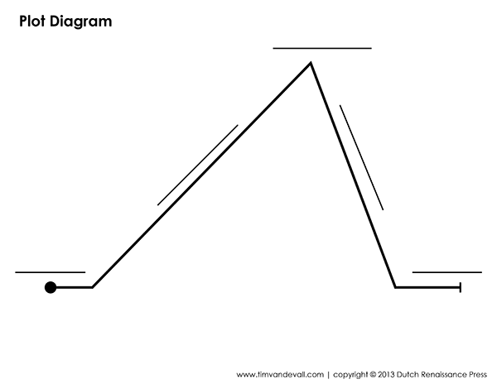
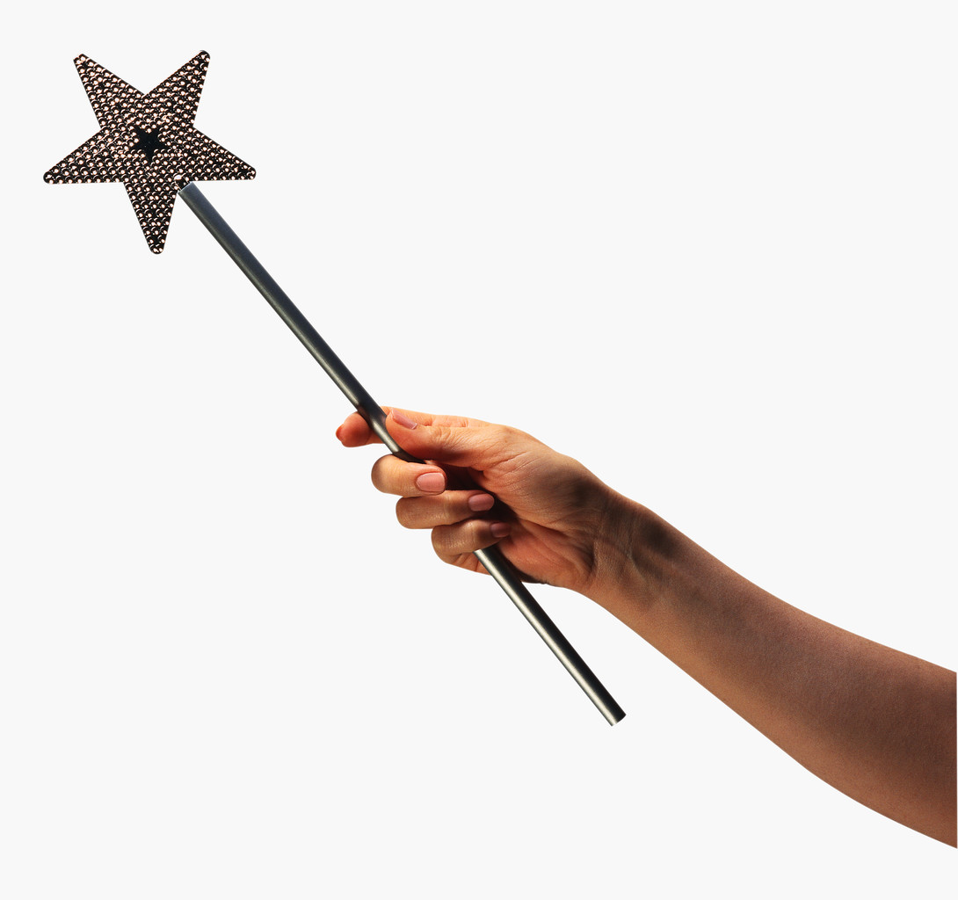
Deus ex machine
99 Problems
But I Can’t Fix One
Mo’ Money
Mo’ Problems
MAGIC SOLUTION
Unfixable
Problem
Notes:
Latin: meaning god from the machine
plot device where seemingly unresolvable problem is suddenly and abruptly resolved by the contrived and unexpected intervention of some new event, character, ability or object
in modern literature, this plot device is generally deemed undesirable

Slide 16
major literary movements overview

Slide 17
Overview: What is a literary movement
Trends defined by time period shared intellectual, historical, religious, and artistic influences

Slide 18
Realism: 1850’s-1900
Realism: literature as a faithful representation of reality
Spawned by the Civil War
Boring people matter too
Dialect
Regionalism was a type of realism that focused on a particular geographical area
Place Personified
Mark Twain, Kate Chopin, Charles Chesnutt
Notes:
Everyday people and their lives

Slide 19
Naturalism: 1865-1900
Naturalism was a more extreme form of Realism
emphasized man’s lack of power against nature
pessimistic; often uses nameless characters
heredity, environment, and fate control character’s outcomes
Notes:
London, Crane, and Dreiser

Slide 20
Modernism: 1900-1950
WWI, Prohibition, and the Great Depression
(Present day) people suck → nostalgia for simpler times
America seems to lose her innocence
Disillusionment and the impersonal nature of the world are major themes
Ex-pats

Slide 21
Harlem renaissance: 1920-1929
African-American artists, writers, musicians, and performers were part of a great cultural movement that sprung out of the jazz clubs in New York City, Chicago, and New Orleans
Mainstream America was gathering an appreciation for African art and culture
addressed issues of race, class, religion, and gender

Slide 22
Postmodernism
Contemporary literature; Postmodernism is an amalgam of many techniques and styles
“Truth”= Irony=
Narrator/Plotlines^{over 9,000}
Nature of being, existing, or reality
So what?
Why is this significant?
And we care because…?

