Slide 1
Basic Literary Terms
English 9

Slide 2
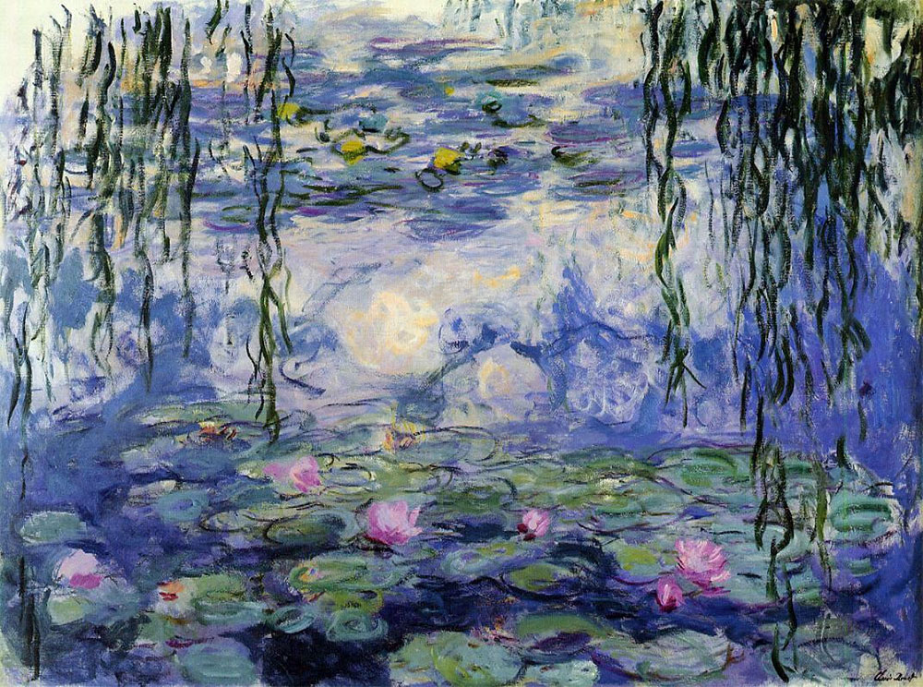
Mood
the atmosphere created through use of figurative language, diction, and imagery

Slide 3
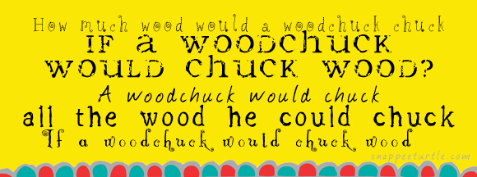
Alliteration
repetition of the same sound at the beginning of multiple words

Slide 4
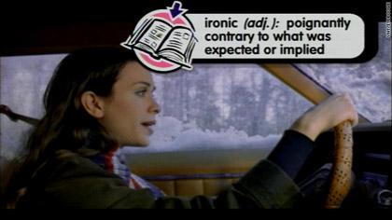
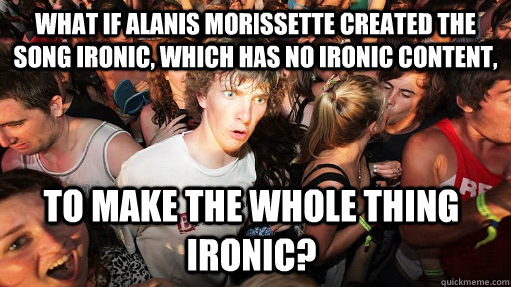
Irony
the use of language that normally means the opposite
https://www.youtube.com/watch?v=32LCwZFoKio

Slide 5
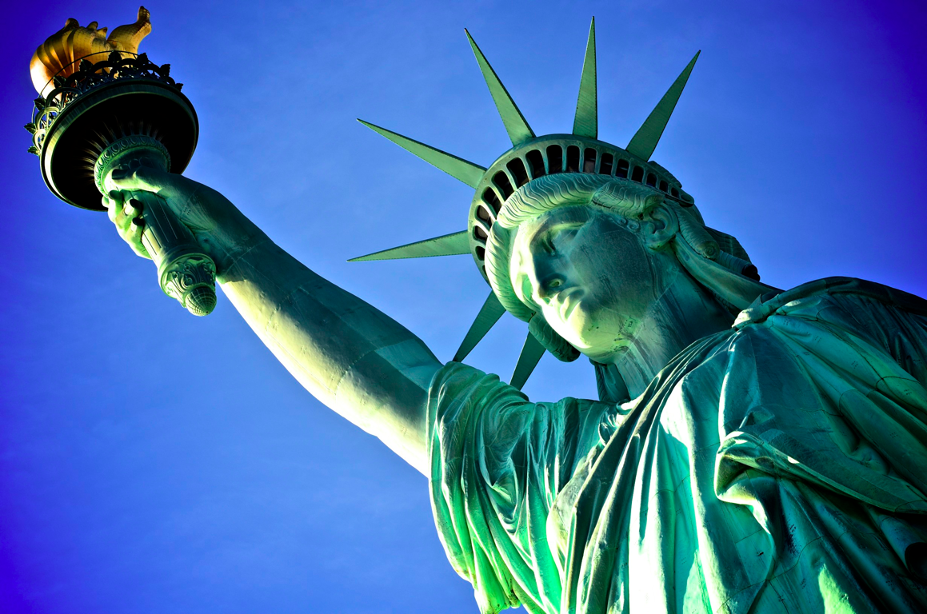
Symbol
a person, place, or object that represents a larger idea

Slide 6
Simile

Slide 7
Metaphor

Slide 8
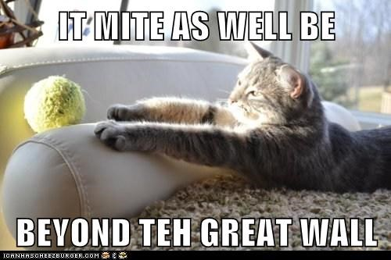
Hyperbole
exaggeration to express strong emotion or create comic effect

Slide 9
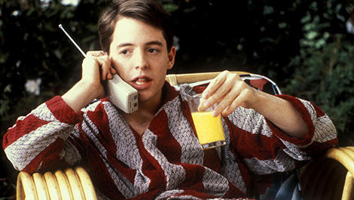
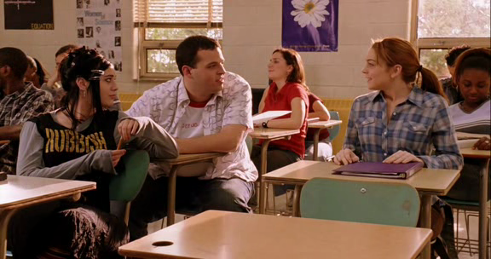
1st Person Point of View
the narrator is a character in the text

Slide 10
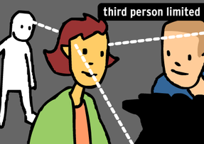
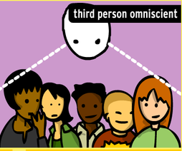
3rd Person Point of view
Third-Person Limited Point of View- the narrator tells what only one character’s perspective
Third-Person Omniscient Point of View- the narrator is all-knowing; the narrator sees into the minds of all characters

Slide 11
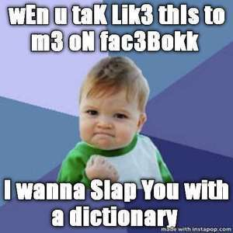
Diction
a writer’s or speaker’s choice of words

Slide 12
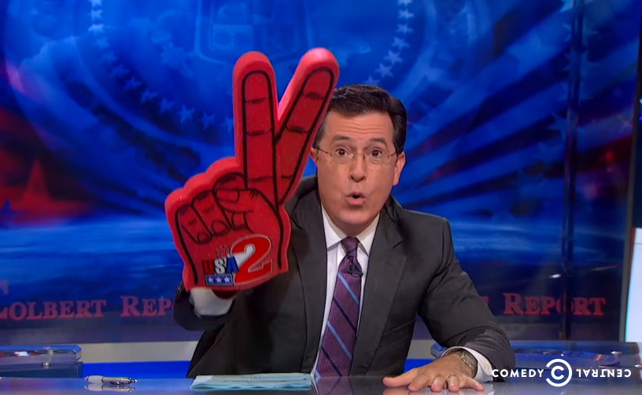
Tone
an attitude a writer takes toward a subject
https://www.youtube.com/watch?v=zTy-B-RTUXc

Slide 13
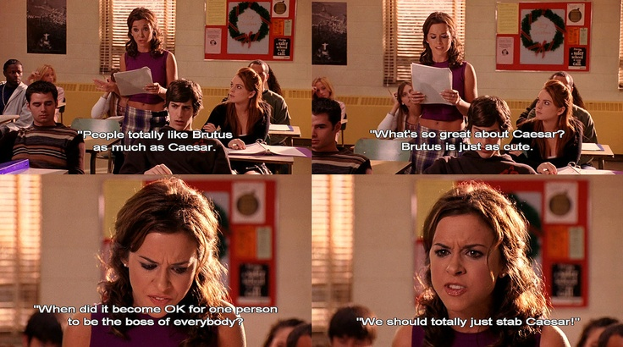
Allusion
an indirect reference to a person, place, event, or thing—real or fictional
https://www.youtube.com/watch?v=PPfjHD0yXQw (0:26)

Slide 14
Denotation
literal, dictionary definition of a word

Slide 15
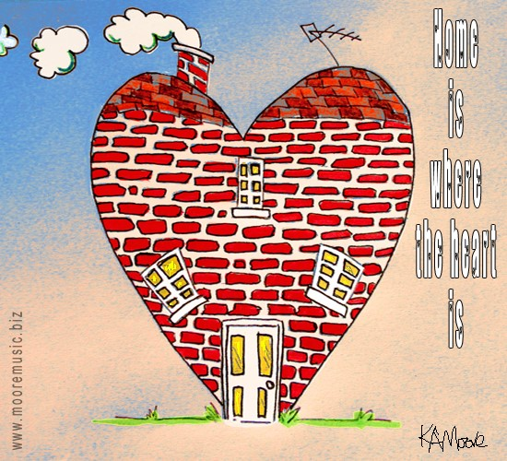
Connotation
meaning derived from attitudes associated with a word

Slide 16
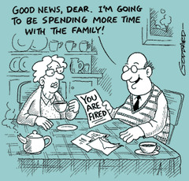
Euphemism
a mild or indirect word or expression substituted for one considered to be too harsh or blunt when referring to something unpleasant or embarrassing

Slide 17
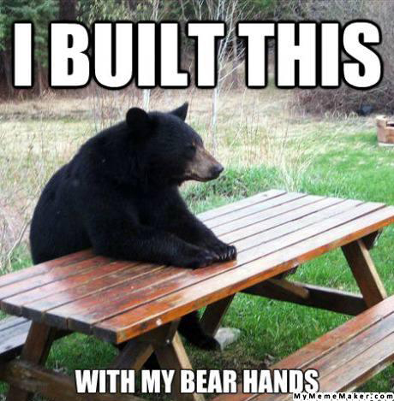
Pun
a phrase that deliberately confuses similar-sounding words for humorous effect

Slide 18
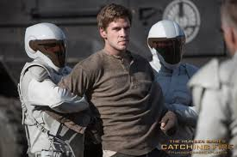
Theme
a central, universal idea within a literary text

Slide 19
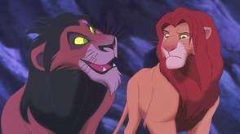
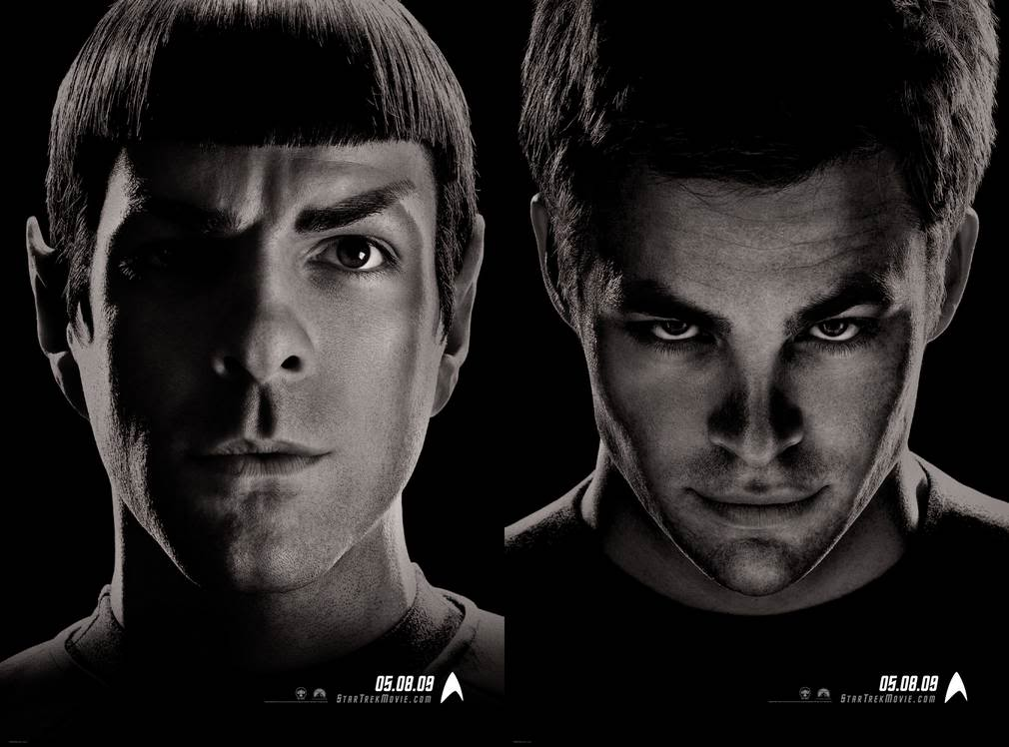
Foil
A character who provides a contrast to another character (usually the protagonist)

