Slide 1
Critical Approaches to Literature Pt. II
Advanced English 9

Slide 2
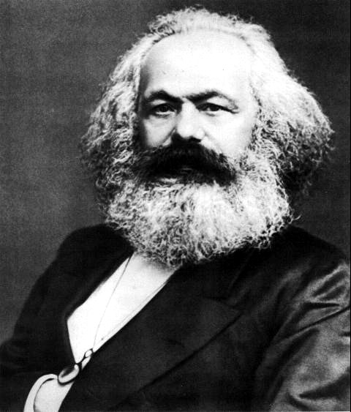
5. The Classist/Marxist Approach
Marxist Criticism MONEYMONEYMONEYMONEYMONEY…MONEY!
☹
Notes:
According to Marxists, even literature itself is a social institution and has a specific ideological function, based on the background and ideology of the author.
emphasizes economic and social conditions. It is based on the political theory of Karl Marx and Friedrich Engels.
Concerned with understanding the role of power, politics, and money in literary texts ☹
the material dialectic. This belief system maintains that "...what drives historical change are the material realities of the economic base of society, rather than the ideological superstructure of politics, law, philosophy, religion, and art that is built upon that economic base" (Richter 1088).
Marx asserts that "...stable societies develop sites of resistance: contradictions build into the social system that ultimately lead to social revolution and the development of a new society upon the old" (1088). This cycle of contradiction, tension, and revolution must continue: there will always be conflict between the upper, middle, and lower (working) classes and this conflict will be reflected in literature and other forms of expression - art, music, movies, etc.

Slide 3
The Classist/Marxist Approach
Marxist Criticism examines literature to see how it reflects
Majority > Minority
I’m all alone, there’s no one here beside
Notes:
Marxist Criticism examines literature to see how it reflects
The way in which dominant groups (typically, the majority) exploit the subordinate groups (typically, the minority)
The way in which people become alienated from one another through power, money, and politics

Slide 4
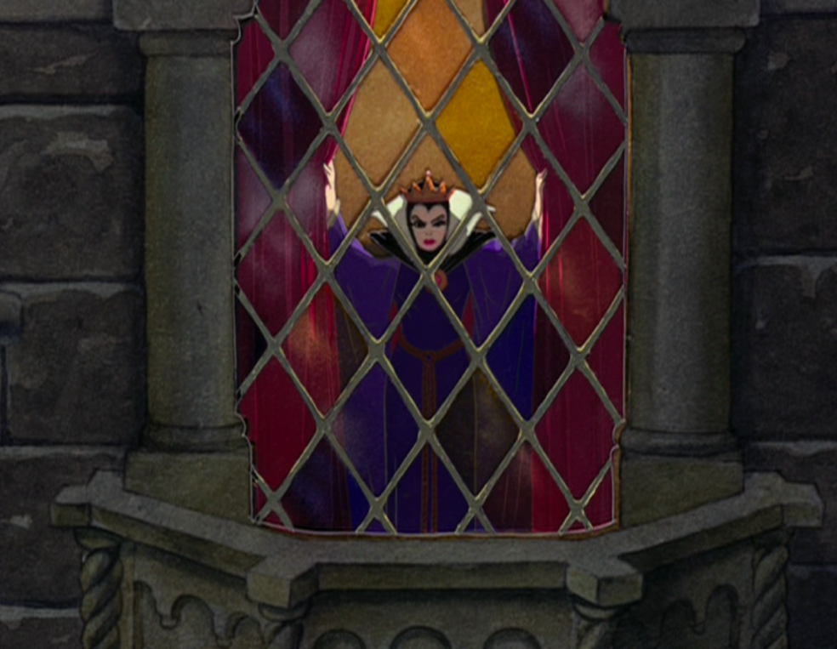
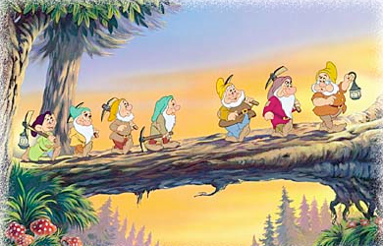
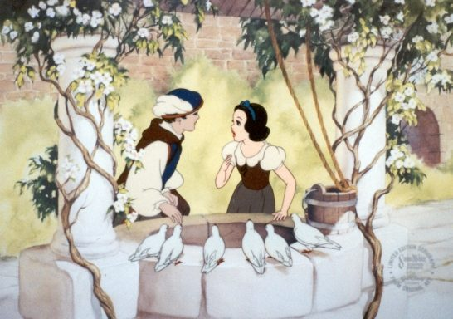
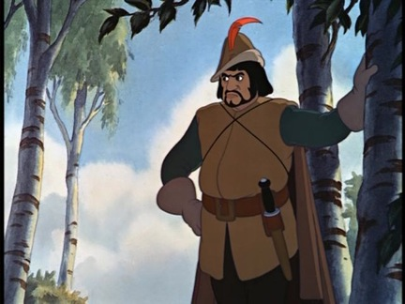
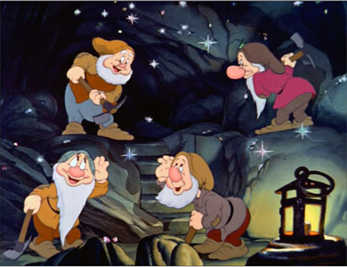
Marxist/Classist Criticism: Example
Power is often predicated on the distribution of socioeconomic power and status

Slide 5
Essential Questions for Marxist Criticism
Whom does it benefit if the work or effort is accepted/successful/believed, etc.?
What is the social class of the author?
Which class does the work claim to represent?
What values does it reinforce? Challenge?
What social classes do the characters represent?
How do characters from different classes interact or conflict?

Slide 6
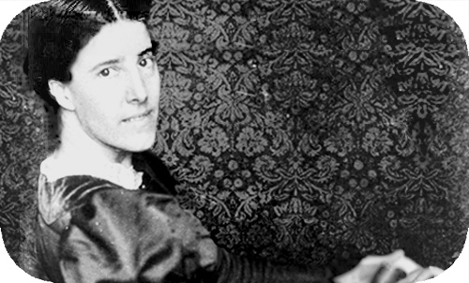
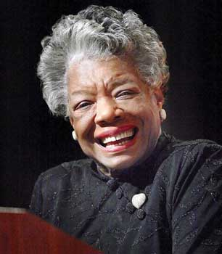
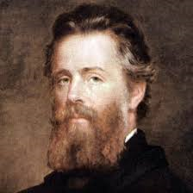
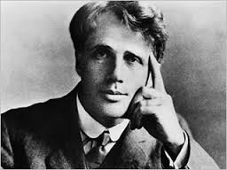
6. The Biographical Approach
Biographical Criticism This analysis just got REAL.
Notes:
Looks at an author’s life….um duh.

Slide 7
The Biographical Approach
Three Benefits:
Feels like an answer key.
Empathy.
Judy judge.
Notes:
Facts about an author’s experience can help a reader decide how to interpret a text.
A reader can better appreciate a text by knowing a writer’s struggles or difficulties in creating that text.
A reader can understand a writer’s preoccupation by studying the way they apply and modify their own life experiences in their works.

Slide 8
Essential Questions for Biographical Criticism
What aspects of the author’s personal life are relevant to this story?
Which of the author’s stated beliefs are reflected in the work?
Does the writer challenge or support the values of her contemporaries?
What seem to be the author’s major concerns? Do they reflect any of the writer’s personal experiences?
Do any of the events/characters in the story correspond to events/people experienced by the author?

Slide 9
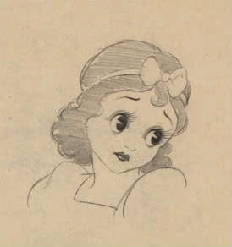
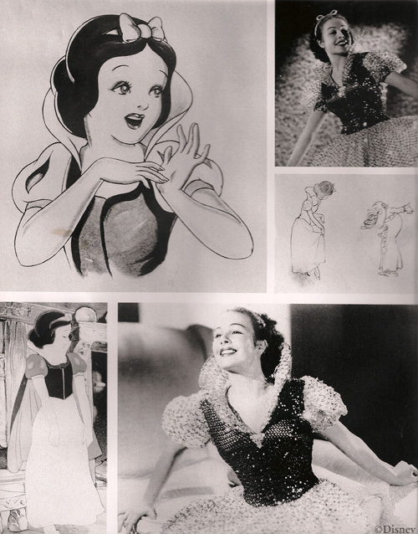
Example Biographical Criticism
Real women have
3-dimensional curves
Notes:
-Disney could not find a voice for Snow White. Around 150 girls auditioned for the role of Snow White,^{[6]} including well-known actresses such as Deanna Durbin,^{[7]} whose voice seemed too old to Disney.^{[8]} One assistant to Disney called his friend and teacher vocal music Guido Cazelotti, complaining that Hollywood had no singing girls. Cazelotti wanted to offer to send their best to listen to the students, but it turned out that his 20-year old daughter Adriana overheard a conversation on another phone in the house, and she sang in a tube and has demonstrated her shrill girlish voice.^{[9]} Her father was confused and told his daughter to get away from the phone, but the casting director liked her voice and invited her to audition. After Walt Disney heard her, he immediately gave her a role.^{[10][11][12]}
The studio signed a multi-page contract with Adriana Caselotti: she was forbidden to sing in a movie or on the radio before the movie,^{[citation needed]} instead she received $970 (now worth approximately $15,913).^{[7]}
Caselotti’s house in L.A. resembled a certain woodland cottage, including a wishing well in the front yard.

Slide 10
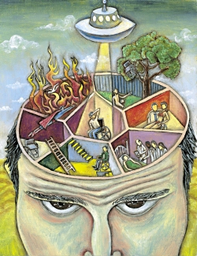
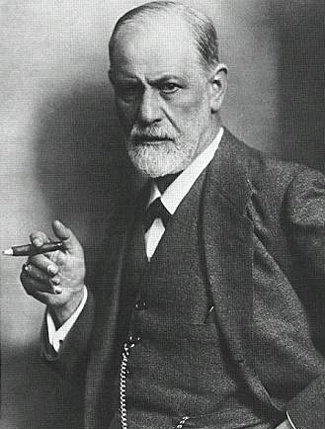
7. The Psychological & Psychoanalytic Approach
Psychological Criticism
Based on Freud.
Also focuses on the hidden motivations of literary characters
Notes:
views a text as a revelation of its author’s mind and
Looks at literary characters as a reflection of the writer and his or her own hidden motivations
personality.

Slide 11
Types of Psychological Consciousness
Id:
Ego:
Superego:
Notes:
only part present from birth, based on instinctual needs and desires
present from age 1, “attempts to mediate between the Id and reality” to fulfill long-term desires realistically
present from age 5-7, reflects the internalization of cultural rules, mainly taught by parents applying their guidance and influence

Slide 12
ID– EGO-- SUPEREGO

Slide 13
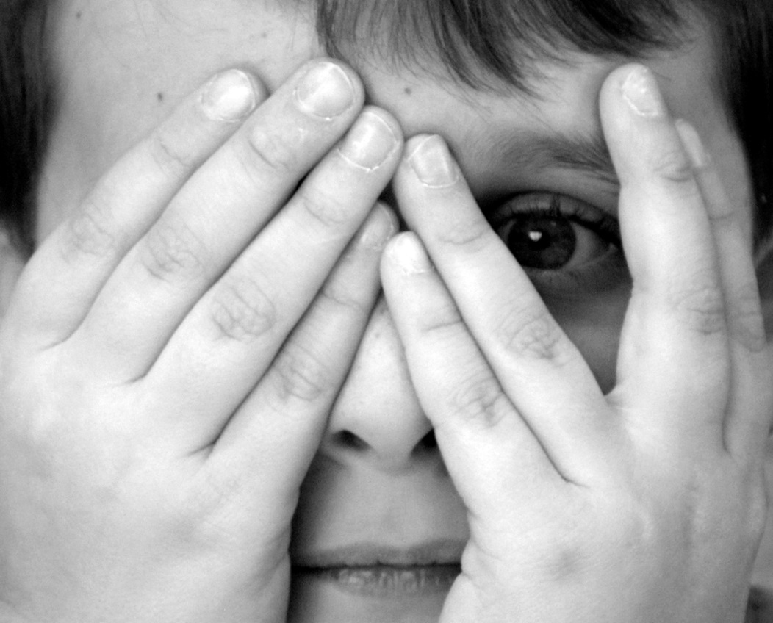
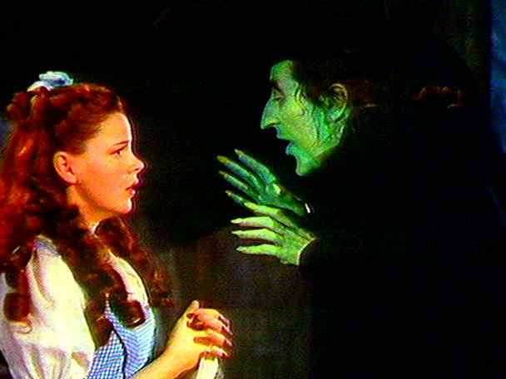
Repression
“motivated forgetfulness”
The unintentional mental blocking of a traumatic situation, person, or event
Notes:
Phobia: generally a result of a repressed traumatic event

Slide 14
Projection
“outward displacement”
tendency to see your own unacceptable desires and behavior in others

Slide 15
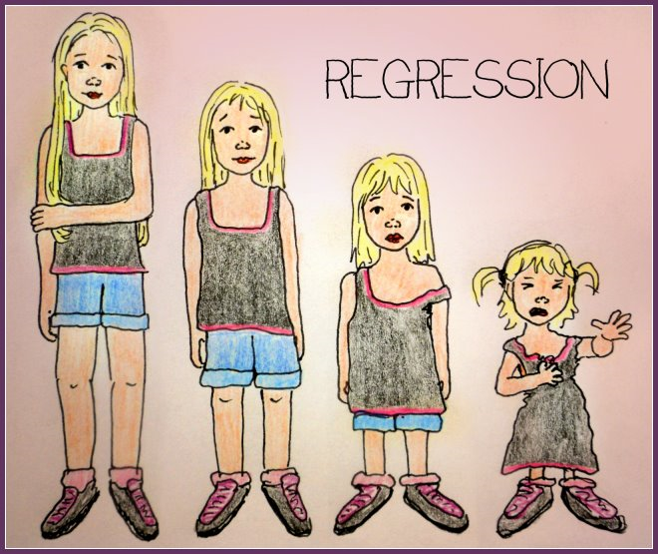
Regression
a movement back in time (developmentally) when facing stress or a traumatic event
Often results in primitive or childlike behavior when threatened
Notes:
Ex. when confronted by evidence of disloyalty from a significant other, a gentleman initiates a fistfight with the opposing suitor

Slide 16
Rationalization
dealing with an emotion intellectually to avoid emotional involvement or investment
Notes:
Ex. “Everybody else speeds on the highway, do I don’t have to feel guilty about speeding too”

Slide 17
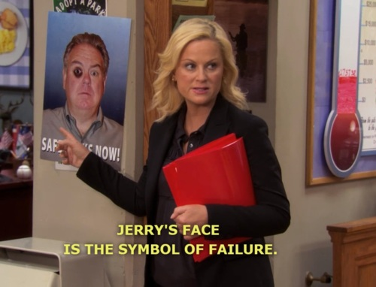
Displacement
satisfying an impulse with a substitute object
scapegoating

Slide 18
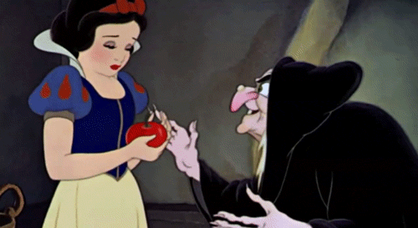
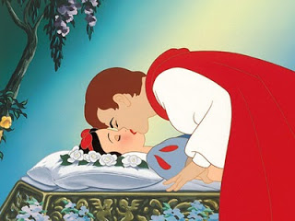
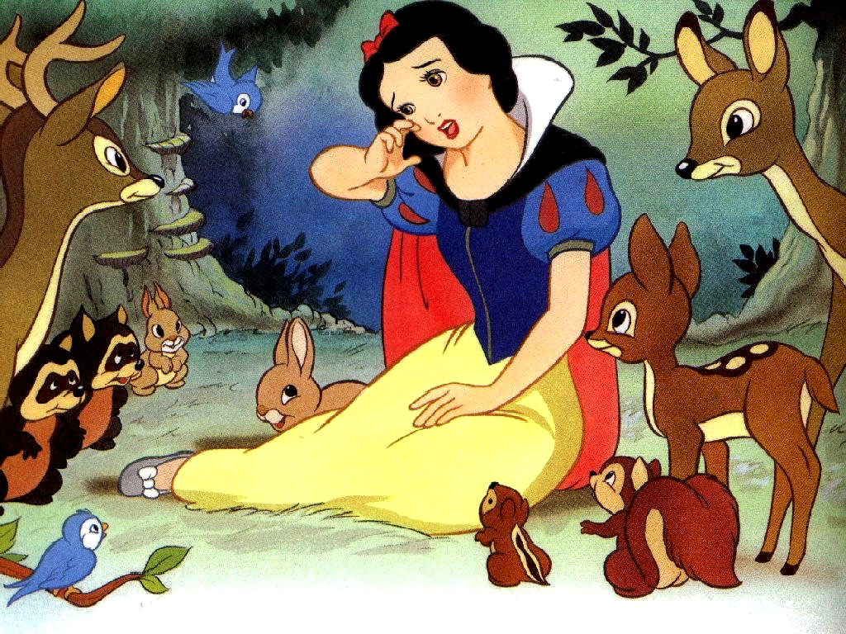
Example Psychological Criticism
Notes:
Prince Florian=Superego
Queen/Hag=ID
Snow=Ego
-Queen DISPLACES issues onto Snow
-Snow represses in a coma
-Virginity/morality v. sexual temptation

Slide 19
Essential Questions for Psychological Criticism
What forces (conscious, unconscious, subconscious) are motivating the characters?
What conscious or unconscious conflicts exist between the characters?
Do any of the characters correspond to the id, ego, and superego?
How does the work reflect the writer’s personal psychology?
What do the characters’ emotions and behaviors reveal about their psychological states?

Slide 20
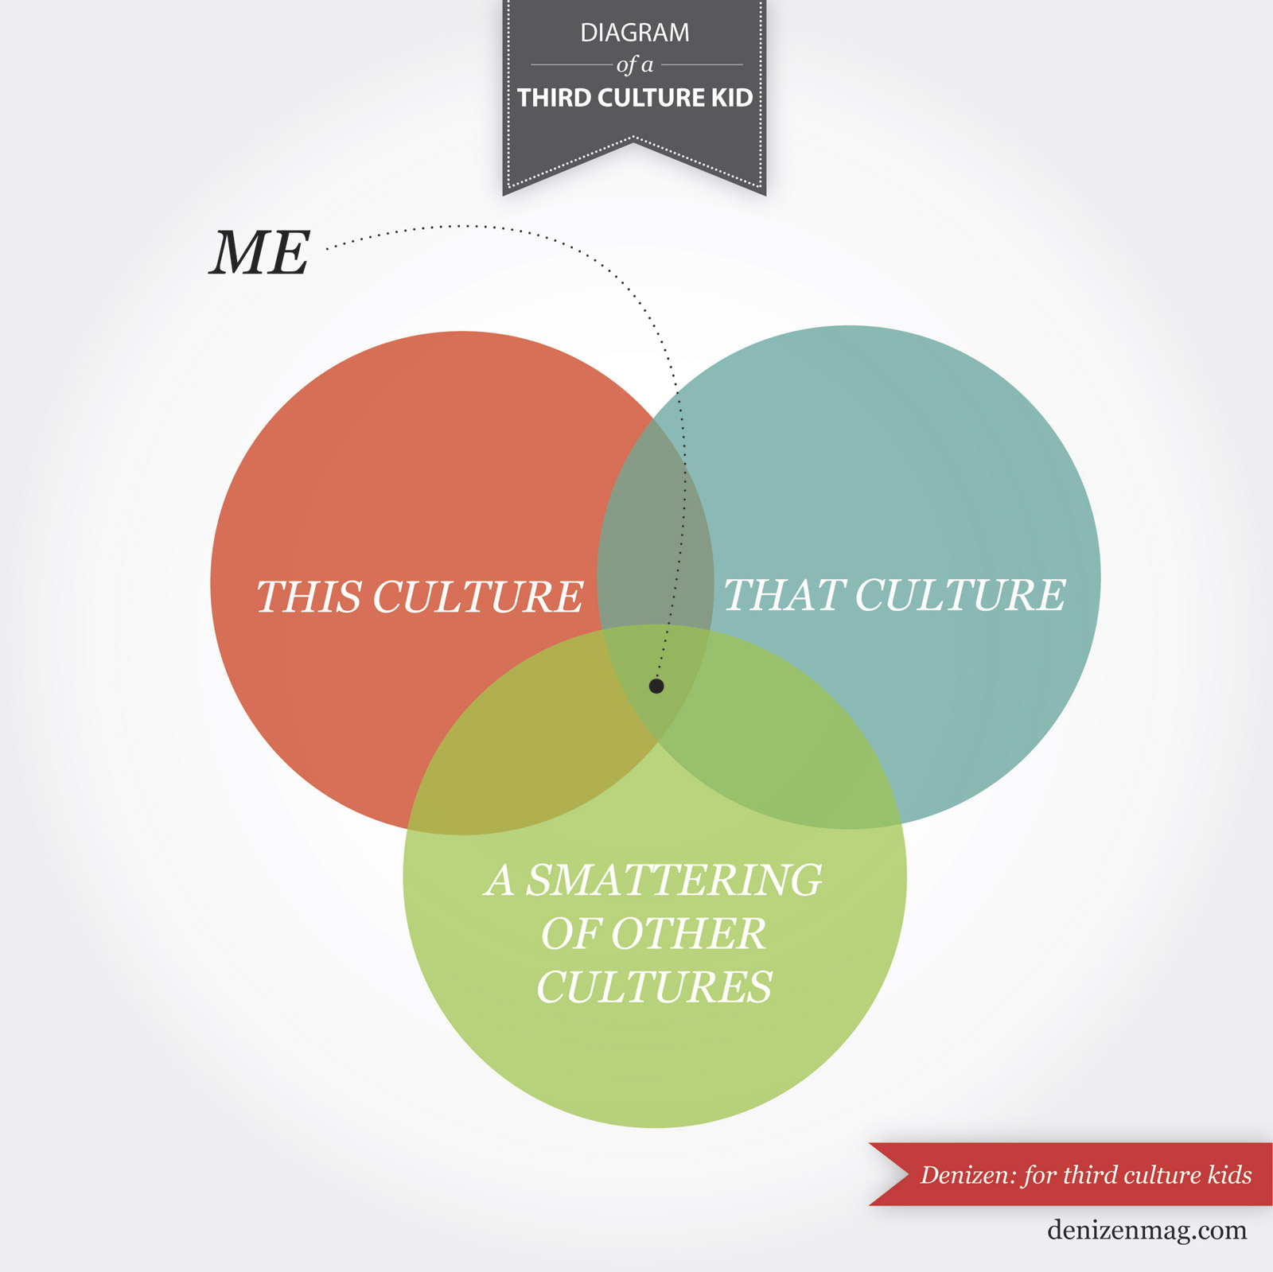
8. Cultural Studies
Related to race, ethnicity, socioeconomic status, religion, etc.
Notes:
mostly reader-centered: the reader approaches the text from a distinct, culturally-informed perspective. This perspective can be related to a character’s race, ethnicity, socioeconomic status, religion, sexual orientation, gender, etc.
There are many, more specific subsets within a multicultural approach.
A major goal for cultural critics is to expand the canon to include texts by more writers of different races and ethnicities.

Slide 21
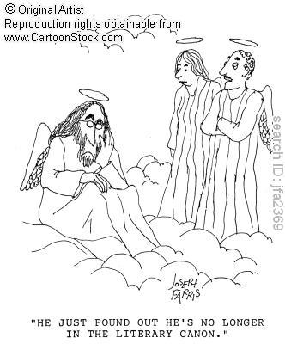
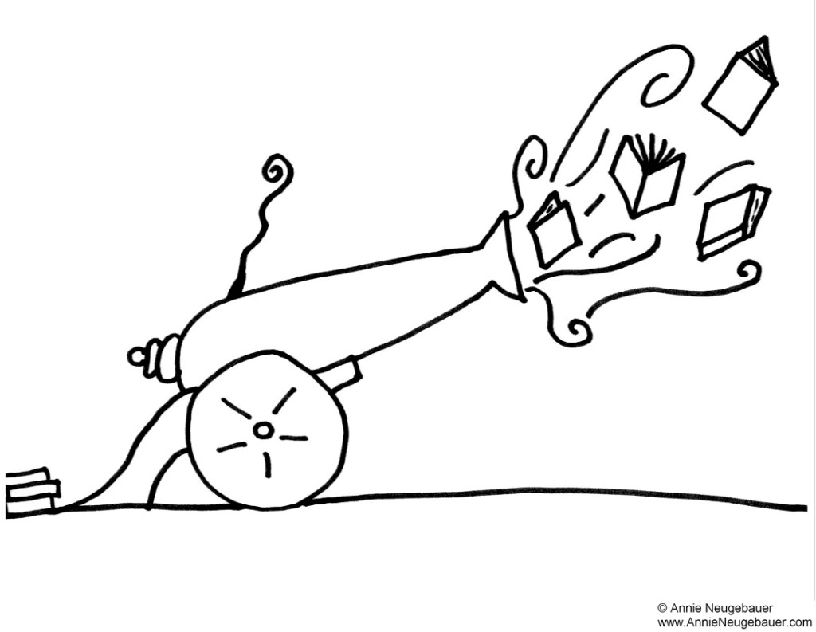
Basic beliefs
Seeing double (consciousness)
The Canon
Change the Canon, change the world
Notes:
1. Categories of race and ethnicity have been used in ways that have empowered and oppressed.
2. This differentiation of peoples, is reflected in and reinforced by languages and metaphor.
4. This differentiation of peoples and its political consequences are reflected not only in the literary and other forms of representation but also in our very notion of literature.
5. Thus an understanding of textual reflections of racism and ethnocentrism demands an attention to the cultural history and belief systems of the social group(s) being portrayed and discussed.
6. The analysis of racism and ethnocentrism in texts from the past may have relevance to the ways we live our lives today.
In W.E.B. Dubois, we find an early attempt to theorize the position of African-Americans within dominant white culture through his concept of “double consciousness,” a dual identity including both “American” and “Negro.” Dubois and theorists after him seek an understanding of how that double experience both creates identity and reveals itself in culture. Afro-Caribbean and African writers—Aime Cesaire, Frantz Fanon, Chinua Achebe—have made significant early contributions to the theory and practice of ethnic criticism that explores the traditions, sometimes suppressed or underground, of ethnic literary activity while providing a critique of representations of ethnic identity as found within the majority culture.
Dubios “Racial Uplift”

Slide 22
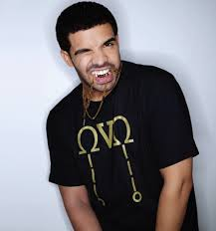
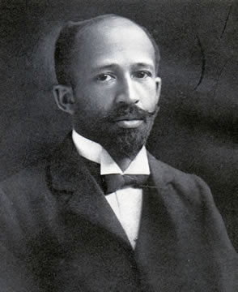
Drawbacks
Literary studies
Cultural Canon
“Awareness”
Cultural
Notes:
“[T]here are two enemies of reading now in the world, not just in the English-speaking world. One [is] the lunatic destruction of literary studies...and its replacement by what is called cultural studies in all of the universities and colleges in the English-speaking world, and everyone knows what that phenomenon is. I mean, the...now-weary phrase 'political correctness' remains a perfectly good descriptive phrase for what has gone on and is, alas, still going on almost everywhere and which dominates, I would say, rather more than three-fifths of the tenured faculties in the English-speaking world, who really do represent a treason of the intellectuals, I think, a 'betrayal of the clerks'.“

Slide 23
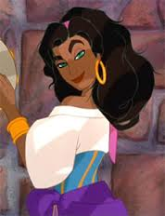
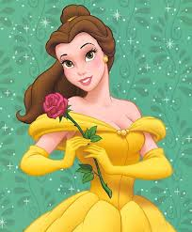
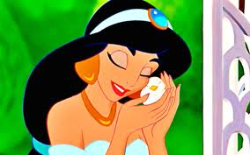
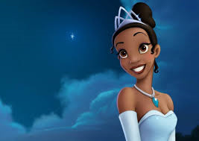
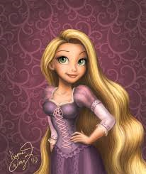
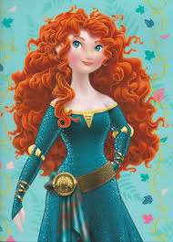
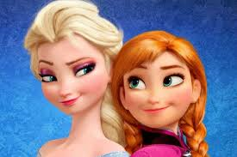
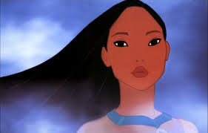
Cultural Criticism Example
Cultural beliefs, values, perceptions, and experiences fundamentally impact meaning and significance

Slide 24
Essential Questions for Cultural Criticism
What does the text reveal about the problems of cultural identity, including the relationship between personal and cultural identity and such issues as double consciousness and hybridity?
What person(s) or groups does the work identify as "other" or stranger? How are such persons/groups described and treated?
What does the text reveal about the operations of cultural difference - the ways in which race, religion, class, gender, sexual orientation, cultural beliefs, and customs combine to form individual identity - in shaping our perceptions of ourselves, others, and the world in which we live?
How does the text respond to or comment upon the characters, themes, or assumptions of a canonized (colonialist) work?

Slide 25
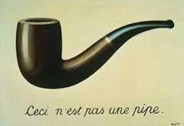
Deconstruction
[POST]Structuralism
Language→Reliable (?)
=
Notes:
-Originates in the 60s and 70s, wider critical approach “poststructuralism”
-Structuralism- designed to show all elements of human culture (including lit) are understandable as parts of a system of signs
-Texts are unified and have identifiable “centres” of meaning
-These structures rely on binary oppositions
-Poststructuralist say that means that no meaning can exist outside language
→No such thing as an autonomous system
-Binaries are often not opposite at all; the “differ” but also “defer”; their meanings overlap rather than being mutually exclusive
-Deconstruction/Poststructuralists→no clear meaning
-Deconstruction NOT SYNONYMOUS with Poststructuralist

Slide 26
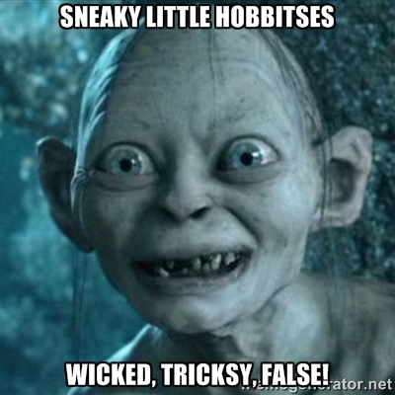
Basic Beliefs of Deconstruction
Author R.I.P.
Always Never use Absolutes
Words=
Notes:
The author is dead
There are no absolutes in logic, religion, science, or langauge
-absolutes-Existing without relation to any other being; self-existent; self-sufficing (Moral: good v. evil)
-Of statements: Free from conditions or reservations; unreserved, unqualified, unconditional (always, never)
3. Meanings of words are slippery, fluid, changeable, and shifty
4. Seek to find contradictions in the text to prove it lacks unity
→ Look for things like double-negatives that defy binaries

Slide 27
The Deconstructive Approach
Advantages:
Disadvantages:
Multiple Interpretations
Games
Understands my shriveled heart
Multiple Interpretations
It’s all relative (and I mean all)
You = “text”
Notes:
Advantages
Deconstruction allows for Multiple Interpretations
A game; freeplay of words, sounds, and text.
Skeptical and pessimistic about existence
Disadvantages
Deconstruction allows for Multiple Interpretations
Moral, Spiritual, and Cultural Relativism
Life itself is a “text” without any certain meaning and we spend our life trying to “interpret it”
NOTHING IS OUTSIDE THE TEXT

Slide 28
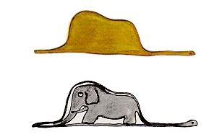
How to:
1. Find Binary→ Bi – nary
2. Surface Features
3. Overanalyze
4. Break the text
Notes:
Identify binary and destabilize
Expose textual subconscious (where meanings contradict or destabilize surface meaning)
Fix upon surface features of the words—consonance, root meanings, dead metaphors—and make them important
Analyze one passage so intensely that the language explodes into multiple meanings
Look for shifts, breaks, inconsistencies, and silences (“aporia”)
Show that the text is disunified

Slide 29
Deconstruction Example
Snow
White
Notes:
Snow→ weather
-Between liquid and solid
-Taken as a type of whiteness or brightness.
-As marking a period of time (winter)
→Geographical (artic)
-Applied to various things having the color or appearance of snow (snow eggs)
-Cocaine
-(Silver) money
Spots that appear as a flickering mass filling a television or radar screen, caused by interference or a low signal-to-noise ratio.
The white hair of age. Chiefly in phrases.
Consisting of or composed of snow
Animal’s name (snow-leopard)
The pure white color of snow
White breasts
N. 2
A small sailing-vessel resembling a brig; formerly employed as a warship
V.
To fall, descend
To deceive or win over with plausible words; to kid, to dupe
With up. To block, obstruct, incommode, imprison, etc., with snow.
U.S. slang. To drug, to dope.
White→ Race
Color→ Actually not, only a shade (absolute)
-The translucent viscous fluid surrounding the yolk of an egg, which becomes white when coagulated
-The white part (sclerotic coat) of the eyeball, surrounding the coloured iris.
-In modern practice, a circular band of white on the target, or each of two such bands (inner white and outer white); hence, a shot that hits this white.
-Printing. The blank space in certain letters or types; a space left blank between words or lines
-White garments or vestments: chiefly in specific uses, esp. (a) surplices worn by clergymen, choristers, etc. (now chiefly Hist.); (b) white trousers or breeches; (c) white clothes worn for sport
-Silver money, ‘silver’ collectively, as distinguished from red or yellow = gold (obs.); also (with pl.) a silver coin (slang). Also (sing.) in general sense, money (slang).
-slang. Morphine. Cf. white stuff
-”in black and white”→ binary/absolutism
-fig. (or in fig. context) as a symbol of purity, goodness, truth, joy, etc.
-White Noise-a constant noise (such as that the noise from a television or radio that is turned on but is not receiving a clear signal) that is a mixture of many different sound waves
-Colourless, uncoloured, as glass or other transparent substance.
-V.
- white-out. Of vision: to become impaired by exposure to a sudden bright light (see also quot. 1981). Also trans., to ‘blind’ (an audience in a theatre) by such means.
To cover or coat with white; to whitewash;
To “white out” (correcting liquid)
-V. 2
-To cut slices off (a stick, etc.) with a knife or other sharp instrument; to pare; to whittle.
-SNOW AND WHITE REDUNDANT AND OVERLAPPING (white characterizes Snow)→ Implies deeper/hidden meaning
-”White as snow” (dead simile)→ cliché
-”No” in snow
-Reinforces racism

Slide 30
Essential Questions for Deconstruction
How is language thrown into freeplay or questioned in the work?
How does the work undermine or contradict generally accepted truths?
How does the work deal with the separation (or lack thereof) between writer, work, and reader?
If we changed the point of view of the text - say from one character to another, or multiple characters - how would the story change? Whose story is not told in the text? Who is left out and why might the author have omitted this character's tale?
Notes:
How is language thrown into freeplay or questioned in the work? For example, note how Anthony Burgess plays with language (Russian vs English) in A Clockwork Orange, or how Burroughs plays with names and language in Naked Lunch.
How does the work undermine or contradict generally accepted truths?
How does the author (or a character) omit, change, or reconstruct memory and identity?
How does a work fulfill or move outside the established conventions of its genre?
How does the work deal with the separation (or lack thereof) between writer, work, and reader?
What ideology does the text seem to promote?
What is left out of the text that if included might undermine the goal of the work?
If we changed the point of view of the text - say from one character to another, or multiple characters - how would the story change? Whose story is not told in the text? Who is left out and why might the author have omitted this character's tale?

Slide 31
REMEMBER…
We will never look at a text STRICTLY from one standpoint or another, ignoring all other views. That is antithetical to what we are trying to do.
We should always keep our focus on the text and use these critical approaches to clarify our understanding of a text and develop an interpretation of it.

