Slide 1
Structuralism and semiotics
Advanced English 9

Slide 2
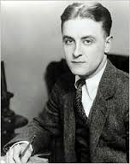
Compulsory Intro Slide
“The test of a first-rate intelligence is the ability to hold two opposed ideas in mind at the same time and still retain the ability to function”
- F. Scott Fitzgerald

Slide 3
StructuralisM
“A fundamental principle of structural and semiotic analysis is that elements of a text do not have intrinsic meaning as autonomous entities but derive their significance from oppositions, which are in turn related to other oppositions in a process of theoretically infinite semiosis”
(Cullen, Pursuit 29)
ARBITRARY
An important part of this theory ^^^ is that elements of a text DO NOT have natural meaning but gather significance from oppositions

Slide 4
Structualism in other words
Literary theory established in the mid 20th century by Claude Levi-Strauss and Roland Barthes
Presumption that all meaning agrees with an existing determinable system of terms, relationships, rules, etc.
Argued that words merely act as symbols representing society’s ideas
Meaning of words = RELATIONSHIP (between word and world, word and society, word and other words) rather than meaning being something fixed and permanent

Slide 5
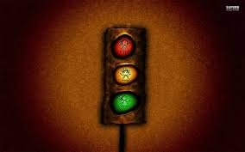
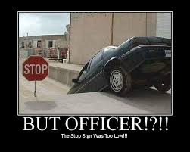
Semiotics
Uses objects (SIGNS) to assign meaning(s) SIGNIFIERS as a means of communication
Language is an example of a sign system
“STOP” = SIGN which SIGNIFIES a discontinuation of movement

Slide 6
Binary oppositions
Binary Oppositions are a fundamental part of creating the STRUCTURE aspect of STRUCTURALISM
Words or phrases that a community generally regards as being opposed to one another; black and white perspective upon the world
One element of the opposition is often perceived as being “favored” over the other; creation of HIERARCHIES
Support established patterns of thinking
Binary Opposition Examples
Mind | Body
Masculine | Feminine
Rational | Emotional
High | Low

Slide 7
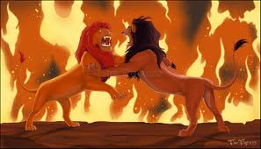
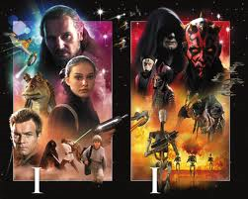
Binaries represented through sign systems

Slide 8
Reasons for binaries
1. The desire to make clear cut divisions is part of our nature as humans as we attempt to make sense of our place in the world.
2. Opposites are the most accessible and natural form of categorization. Traditionally, this is a way that we as humans can signal a warning to others based on the connotation(s) of the two parts of the binary.
*** CAN BE TRACED TO CULTURAL ASSUMPTIONS THAT HAVE BEEN CODED IN THE TEXT

Slide 9
Literary Deconstruction
Advanced English 9

Slide 10
Time to turn on your brain
Can you be in two places at once?

Slide 11
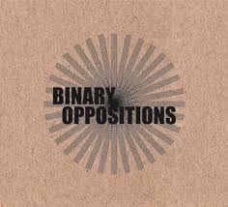
Deconstruction
Literary Theory founded by Jacques Derrida in response to Structuralism
Attends to contradictions and exposes how binary oppositions demonstrate a particular logic or philosophy of meaning
Proceeds to QUESTION the priority of one term over another through the principle of INTERDEPENDENCE
Aka EXPLODING BINARY OPPOSITONS
=

Slide 12
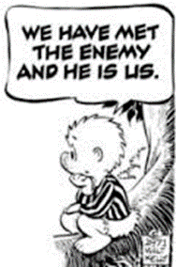
GOAL of literary Deconstruction
Once the hierarchy is questioned and even reversed, the opposition may be displaced into a different context to challenge the function of the opposition

Slide 13
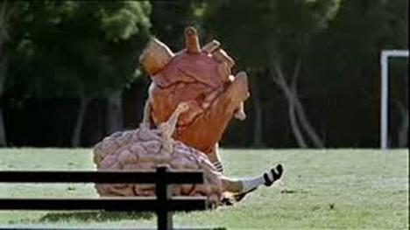
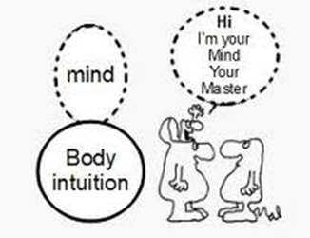
DICHOTOMY=STRUCTURALISM
DICHOTOMY: The division of the world into two opposing sides without overlap. Ex. church and state; follow your head or your heart

Slide 14
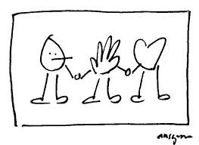
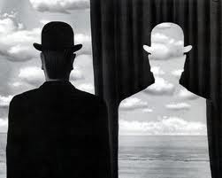
DUALITY=DECONSTRUCTIONIST
DUALITY: The necessary coexistence of two opposites within the same whole. Ex. Duality of man is the state of having a mind and a body, which oppose each other but also work together to form a complete human

